Slide 1
Mathematics and models in science
BIG IDEAS----BIG QUESTIONS---BIG QUESTIONS—BIG QUESTIONS

Slide 2
VOCABULARY SKILL
TREND-A GENERAL TENDENCY OR DIRECTION
PERIODICALLY-AT REGULAR INTERVALS
EVIDENCE-ANY OBJECT OR RESULT THAT INDICATES A CERTAIN THEORY IS TRUE.
RESEARCHER-ANY ONE WHO STUDIES A SCIENTIFIC PROBLEM.
SOCIETY-AN ORGANIZATION OF INDIVIDUALS, SUCH AS THE CITY OF NEW ORLEANS, OR A TOWN.

Slide 3
Lesson 1-Scientific Measurements- Discussion Questions
Big Question-How do scientists use measurements in mathematics? THEY USE A STANDARD MEASUREMENT.
Why do scientists use a standard measurement system?
What standard measurement system does scientist use? Metric system based on the number 10

Slide 4
The modern Scientist use a version of the metric system called the International System of Units (SI)
Why????
What are some SI units of measure?
Why do you think scientists would make a model of a jet and wind test it before building it?

Slide 5
Vocabulary skills- write definitions and use in a sentence
Metric system (based on 10)
International system (SI)
Mass (Kg)
Length (meter)
Weight (Newton)
Volume (M³
Meniscus
Density (d=Kg/M³
Time (second)
Temperature (Celsius)

Slide 6
BIG IDEAS----BIG QUESTIONS---BIG QUESTIONS—BIG QUESTIONS
Complete the column in the table using a meter as the base. The meter is the SI unit for length.
Common SI Prefixes
Prefixes Meaning Example
Kilo-(k) 1,000
Deka –(da) 10
No prefix 1 meter
Centi-(c) 0.01 (one hundreth)
Milli- (m) 0.001 (one thousandth)
Micro –( 0.000001 (one millionth)
Nano- (n) 0.000000001

Slide 7

Do the math-page 58-work as a class=place answers in the textbook
Assess your understanding by answering questions 1 a, b, and c page 58. place work in the textbook.
How long is a kilometer compared to a mile? 1 mile = 1.609 km
The metric system is a
Standard measurement
System based on the number 10.
Modern scientist use the
International System of units
Called SI as the standard.
SI used to compare data And communicate about Results of scientific investigation

Slide 8
Practice problems
The length of this room 23 meters. Convert the length to centimeters. Convert the length to kilometers.
A bobcat can weigh about 95 grams. How many milligrams does it weigh?

Slide 9
SI Units for measurements commonly used
Conversion Table for Length in meters
1 Km=1,000m
1m= 100 cm
1m = 1,000m
1cm= 10mm
Conversion Table for mass in grams
1 kg= 1,000g
1 g= 1,000 mg
Conversion Table for volume in liters
1 L=1,000 mL
1 L= 1,000 cm cubed
1mL = 1 cm cubed
What are some si units of Measure
  Length- measured in meters (m)
  Mass-measured in Kilograms (kg)
  Mass or weight???
  Volume-measured in liters
  Density-Explain???

Slide 10
time and temperture
Celsius-c for centigrade
Kelvin-k for kelvin
See scales page 65
Write definition of words for c and k
What is a thermometer?
Do the quick lab on page 65
Si units for time
  Second
  60 sec. = 1 minute
  60 min. = 1 hour
  3600 sec. = 1 hour

Slide 11
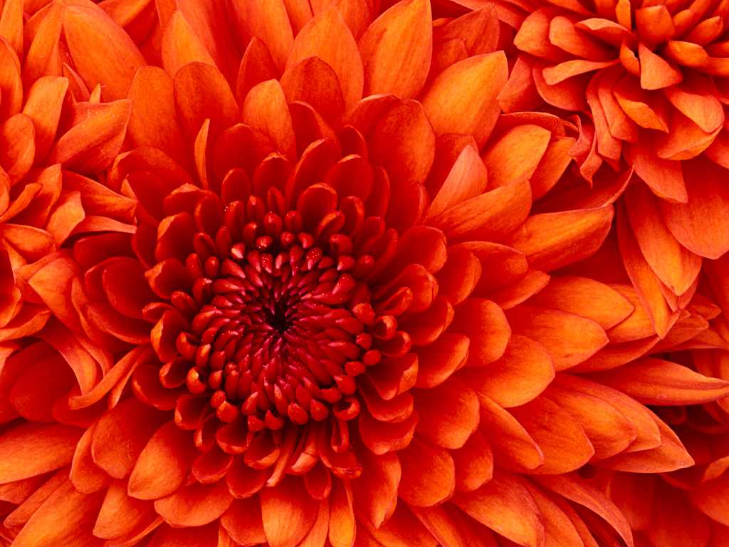
Let’s practice to assess our learning
Review sheet
Quiz time quiz time quiz time quiz time quiz time

Slide 12
Section 2.2
Mathematics AND Scientific Thinking
What math skills do scientist use?
Read “My Planet Diary”
Answer questions out loud page 66

Slide 13
Vocabulary Words
Math Skills MATH TOOLS
Estimate
Accuracy
Precision
Significant figures
Mean
Median
mode
Range
Anomalous data
Percent error
Write definition to all vocabulary words and make a sentence for each

Slide 14
ESTIMATION
AN ESTIMATE IS AN APPROXIMATION OF A NUMBER BASED ON A REASONABLE ASSUMPTION.

Slide 15
When collecting data, scientist use math skills that include estimation, accuracy, and precision, and significant figures.
Class review page 67
Accuracy and Precision
Students will identify main idea in the text page 68
Accuracy-how close the measurement is to the true or accepted measure.
Precision-how close a group of measurements are to each other
Significant Figures-commuincate how precise measurements are.
example-3.2 cm long-3 is significant, .2 is estimated (1 significant fig.)

Slide 16
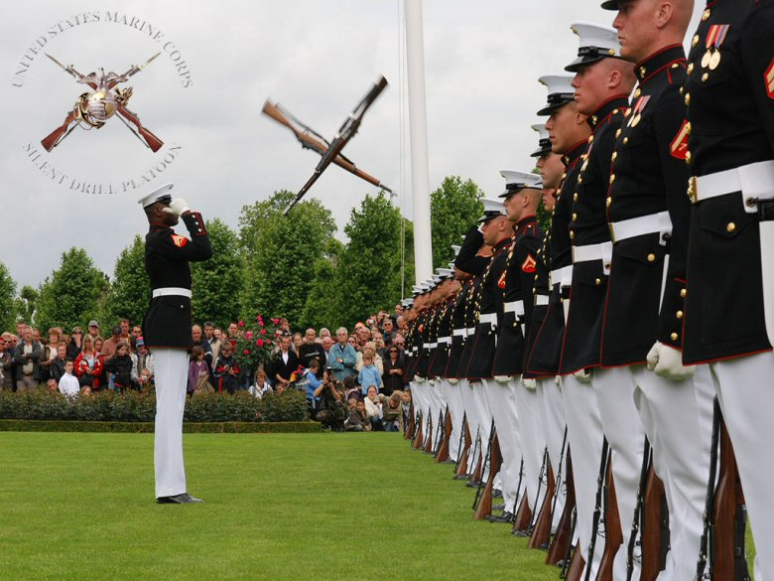

Slide 17
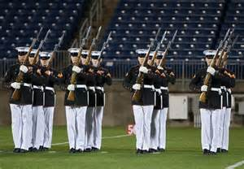
PRECISION

Slide 18
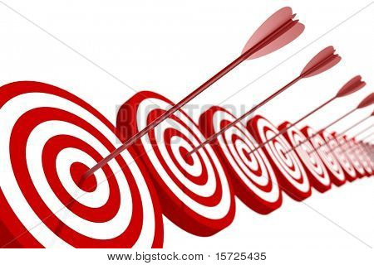
ACCURACY AND PRECISION

Slide 19
MEAN, MEDIUM, Mode, Range
Mean-Average (2, 3, 4, 5,6, 6, 20, 30) add the numbers and divide by the number of numbers
Median-Middle number (5)
Mode-number that occurs most times (6)
Range-difference between smallest and largest number (30-2=28)

Slide 21

Anomalous data =outlier on a graph
Graphs-Line and Bar
Reasonable and anomalous data
2 | 12 | 2 | 5 | 4
1 | 3 | 4 | 3 | 6

Slide 22
Safety in the Science Laboratory
What are two things you should do before you begin any investigation?
What are some additional safety precautions you should take when you work in the field?
What is the most important rule to keep in mind during a science investigation?
What is the purpose of safety symbols?
Why should you handle live animals with care?
Why is it important to follow safety practices during an experiment?
Why is it important to clean up your work area?
See pages 88-893

Slide 23
Safety Practices
What should you do if an accident occur?

